Slide 1





Blockchain
QRBOOKSHIELD
Rewaa Alaa
Yashmine Kashkosh
Hima 2

Slide 2



INTRODUCTION
FRONTEND
TABLE OF CONTENT
CONTRACT

Slide 3
INTRODUCTION
In the evolving landscape of digital publishing, protecting authors' copyrights is paramount. Our innovative solution leverages QR codes and NFTs to secure intellectual property effortlessly.
By scanning a QR code just once, users activate an NFT that encapsulates the book's metadata and copyright information.
This data is then securely stored in MetaMask, ensuring that user information and authorship credentials are immutable and transparent. This system not only fortifies copyright protection but also streamlines the process for both authors and readers, merging the ease of digital access with the robustness of blockchain technology.

Slide 4
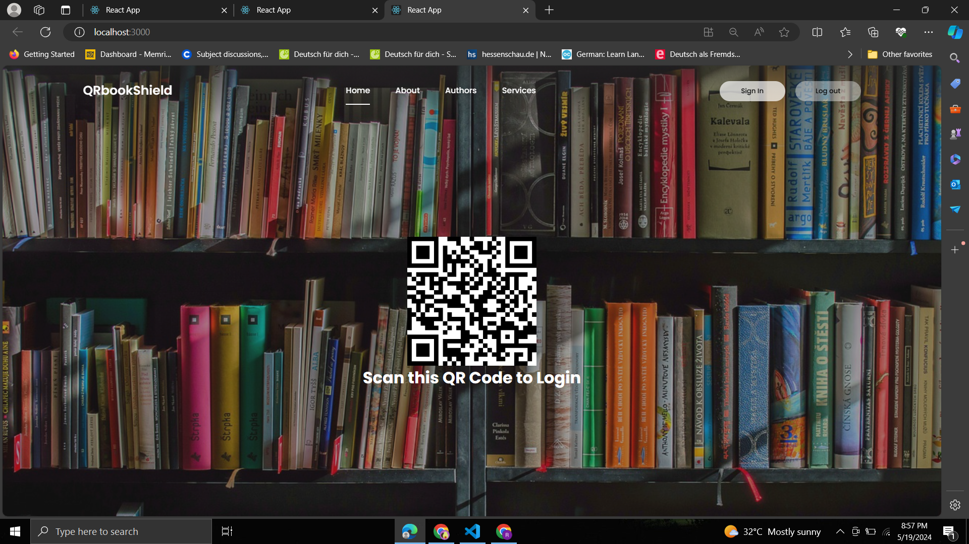

Slide 5
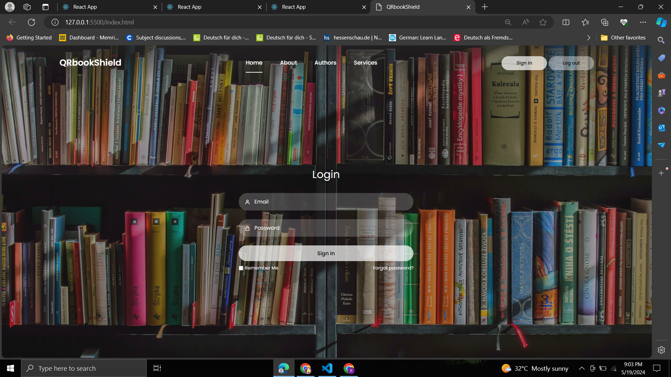

Slide 6
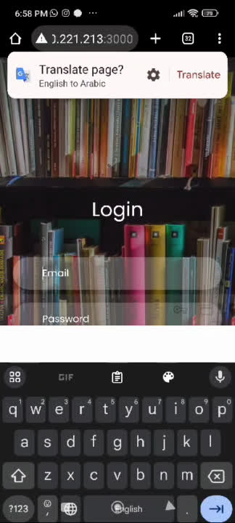

Slide 7

CONTRACT
1) QR
The goal of the QRCode contract is to manage book registration and management, including making sure that a book's QR code can only be scanned once. This contract offers features for adding new books, getting book details, and monitoring QR code scanning progress.

Slide 8
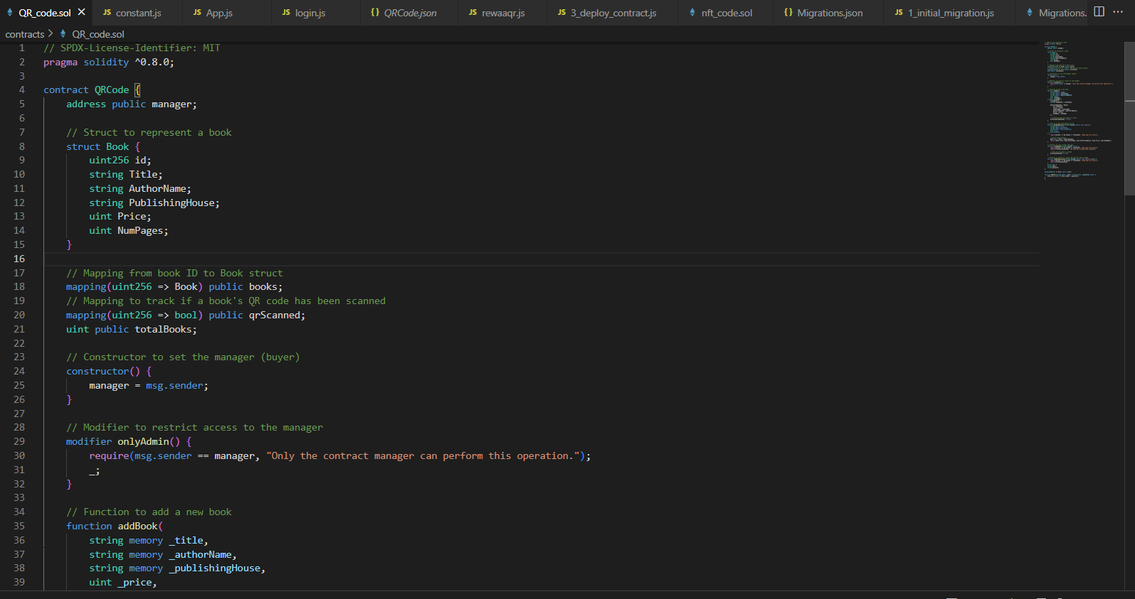
Code highlights:
INTRODUCTION

Slide 9
CONTRACT
2) NFT
The purpose of the BookOwnership contract is to handle book ownership as NFTs, or non-fungible tokens. With a focus on upholding a safe and open record of ownership, it provides features for minting new books, transferring ownership, and retrieving book details.

Slide 10
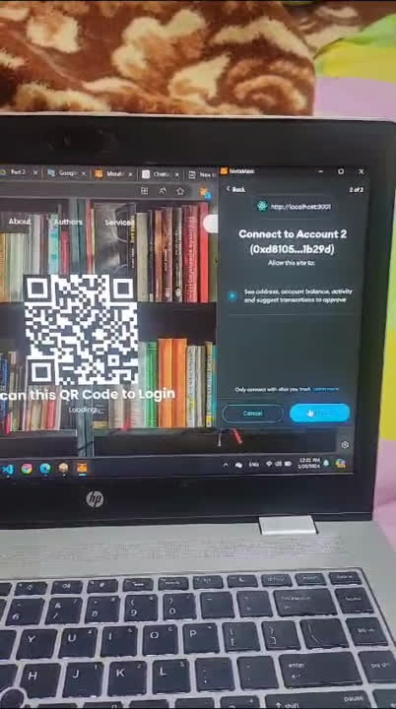
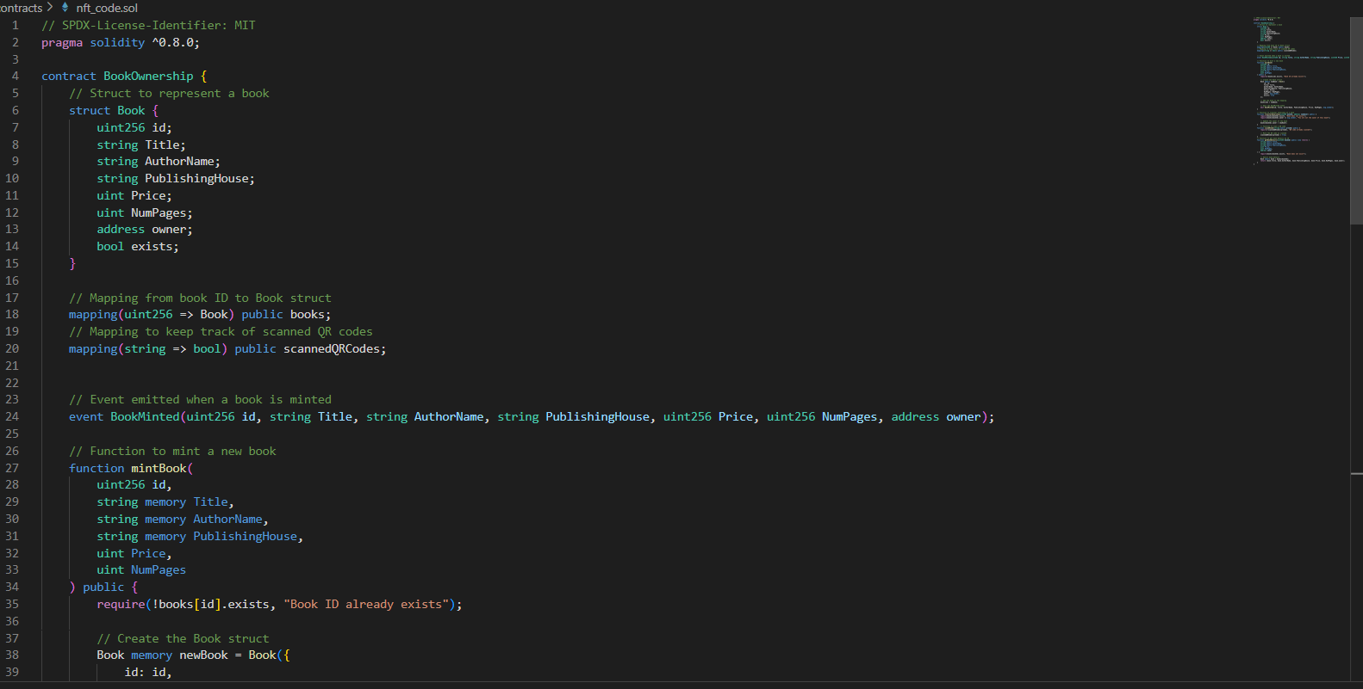
Code highlights:

Slide 11
Blockchain
THANK YOU
for your time and attention
Rewaa Alaa
Yashmine Kashkosh
Hima 2

